Slide 1


PROJECT PRESENTATION
Title: Online Car Rental System
Submitted To,
Mr. Sandeep Padesur
Cranes Varsity

Slide 2
Introduction
What is a Car Rental System?
A digital platform that allows users to book rental cars online, manage reservations, and handle payments efficiently.
Why is it Important?
Increases accessibility and convenience for customers.
Reduces manual paperwork and enhances business operations.
Provides real-time availability and pricing updates.
Industry Demand & Growth
The global car rental market is expected to reach $125 billion by 2027, driven by increased travel and digital transformation.

Slide 3
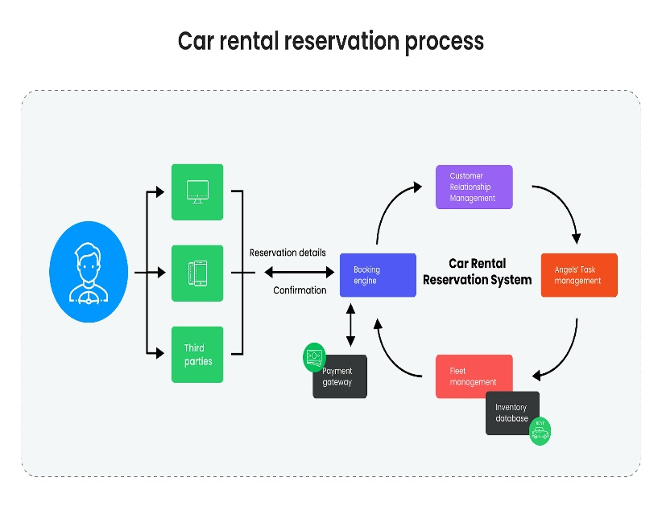
Problem Statement
Traditional car rental businesses use manual systems, leading to errors and inefficiencies.
Customers face difficulty in booking, finding available cars, and estimating rental costs.
Paper-based agreements are prone to loss or damage.
Security risks exist due to weak authentication methods.

Slide 4

Objectives
Develop a user-friendly Car Rental System for both customers and admins.
Enable real-time car availability tracking and secure payment transactions.
Automate pricing and billing based on car type, duration, and demand.
Enhance the user experience with a seamless booking process.

Slide 5
Technology Stack & Development Tools
Frontend Technologies:
Desktop App: JavaFX (Java GUI Framework)
Web App: HTML, CSS, JavaScript
Backend Technologies:
Programming Language: Java
Database: MySQL
Development Tools:
IDE: Eclipse, IntelliJ IDEA (for Java development)
Database Management: MySQL Workbench
Version Control: GitHub
APIs & Integrations:
Google Maps API (for location-based services)
Payment Gateway (Stripe, PayPal) for secure transactions

Slide 6
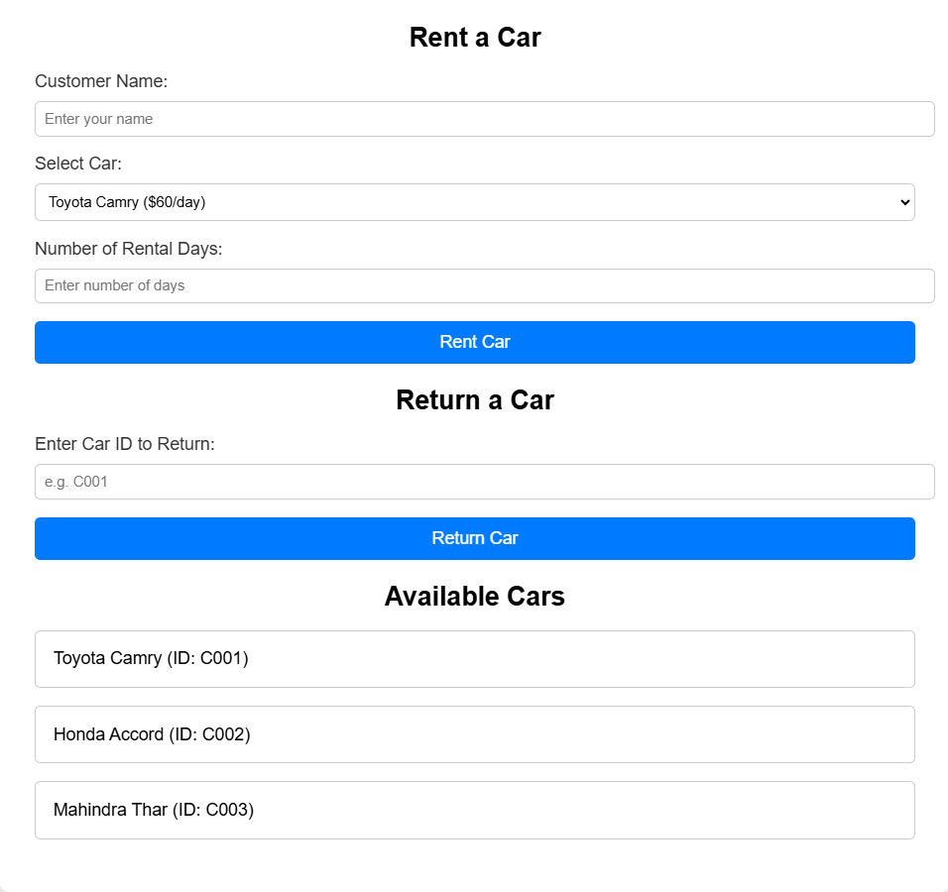
System Features & Modules
Customer Features:
Register/Login with secure authentication.
Search & filter available cars.
Select rental duration & calculate estimated cost.
Make online payments & receive booking confirmation.
Admin Features:
Add, update, and remove cars.
Monitor and approve customer bookings.
Manage pricing, availability, and reports.

Slide 7
Conclusion
The Car Rental System simplifies the car booking process.
Improves customer experience through automation and real-time tracking.
Ensures secure payments and transparent pricing.
Aims to revolutionize car rentals with future AI-driven enhancements.

Slide 8
Submitted By
NAME | REGD No.
Rajat Kumar Sahu | CL2025010601898745
Purnendu Senapati | CL2025010601951352
Rajeet Kumar | CL20250106019056114
Arumbha Paikray | CL2025010601926798
Thank You

